Slide 1
IRIS Feature Engineering
By Anthony and Bennett

Slide 2
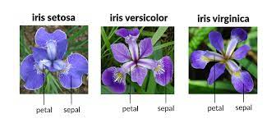
IRIS dataset
Small (150 samples, 3 categories, 4 features)
  Features are: Sepal Length, Sepal Width, Petal Length, Petal Width
One of the oldest classification datasets ever
Neural Nets have historically done well on it (97% acc)
Can we do as well with simpler methods (PCA, KNN, etc)?
Can we do better with Neural Nets?

Slide 3
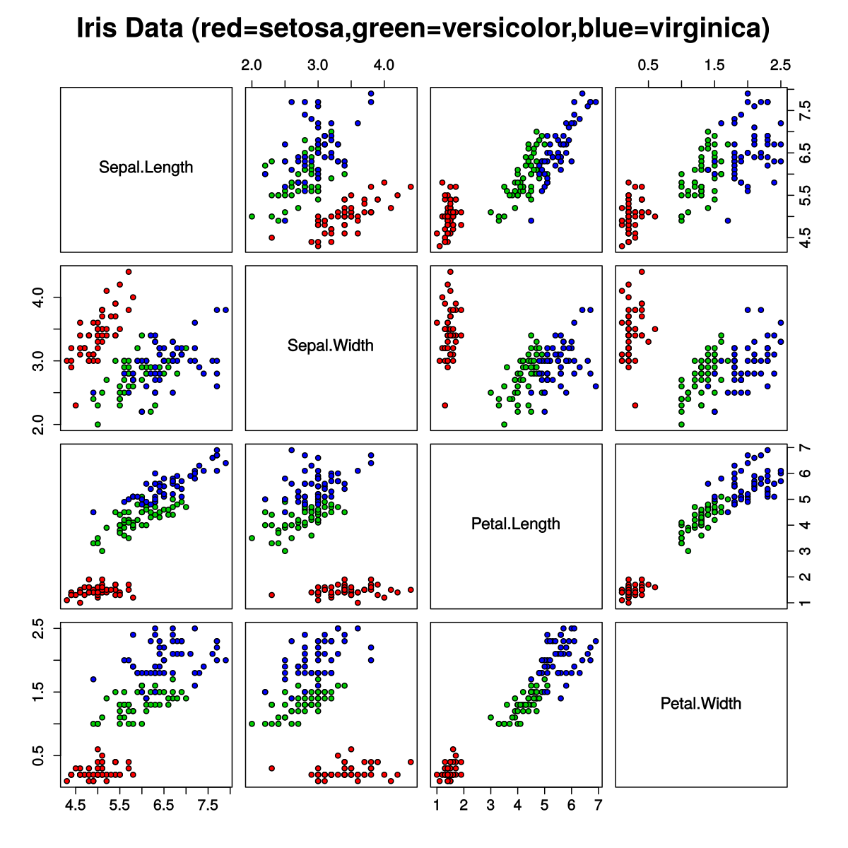
Plan: Feature Engineering/Data Augmentation
Create new features (Sepal Length * Sepal Width, squared data, etc)
Possibly create new data (average values of two same-category data points)?
Dimensionality reduction/transformations (PCA, LDA, tSNE)
See if any of these improve performance of methods
There is also an Enhanced IRIS dataset with far more samples we can test against as well

Slide 4
Thank you!

